Slide 1

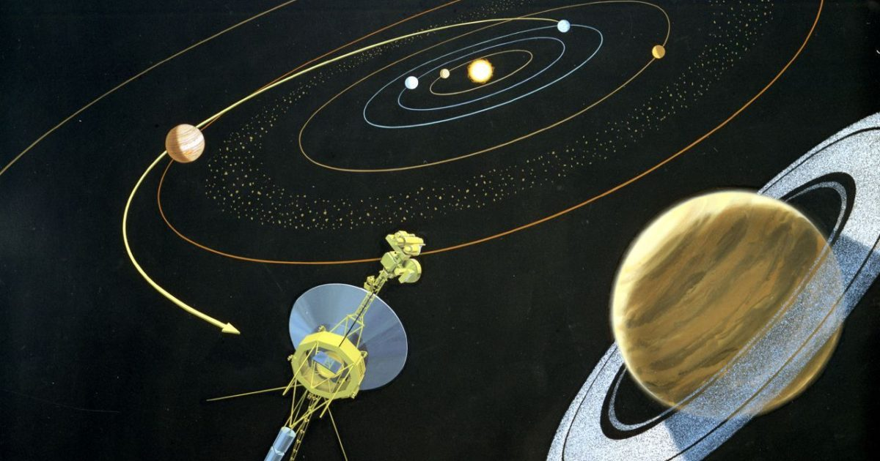
Gravitational Field
Planets can escape the gravitaional hold of their stars and roam in free space. This was only known recently, however this was portrayed in the Quran 1400 years before it was discovered.
Quran 82:2
And if the planets were scattered.
٢ وَإِذَا الْكَوَاكِبُ انْتَثَرَتْ
"Intatharat انْتَثَرَتْ" means scattered. Here planets roam in free space. Today astronomers found scattered planets roaming in free space.
Notes:
Planets Escaping Gravitational field and roam in free space

Slide 2
Birthplace of Abraham
The Christian Bible says that at the birthplace of Abraham people worshiped the sun, moon and stars. Archaeologists found evidence that those people worshiped the sun, moon and "Star of Venus". However today astronomers affirm that this "Star of Venus" is actually the planet Venus, not a star. The Quran correctly describes it as a planet.
Those people thought that Venus was a star. However the Quran didn't do this mistake, it says that it is a planet.
“Kaukab” كَوْكَبً ۖ means planet. Those people worshiped the sun, moon and a planet; not a star.
Quran 6:74-79
Abraham said to his father Azar, “Do you take idols for gods? I see that you and your people are in evident error.” Thus We showed Abraham the empire of the heavens and the earth, that he might be one of those with certainty. When the night fell over him, he saw a planet. He said, “This is my lord.” But when it set, he said, “I do not love those that set.” Then, when he saw the moon rising, he said, “This is my lord.” But when it set, he said, “If my Lord does not guide me, I will be one of the erring people.” Then, when he saw the sun rising, he said, “This is my lord, this is bigger.” But when it set, he said, “O my people, I am innocent of your idolatry. I have directed my attention towards Him Who created the heavens and the earth—a monotheist—and I am not of the idolaters.”
Notes:
The Christian Bible says that at the birthplace of Abraham people worshiped the sun, moon and stars. Archaeologists found evidence that those people worshiped the sun, moon and "Star of Venus". However today astronomers affirm that this "Star of Venus" is actually the planet Venus, not a star. The Quran correctly describes it as a planet.

